Slide 1

Prompt Engineering Basics
Day 6: Learn how to ask AI the right way

Slide 2



What is a Prompt?
Definition: A Prompt
A prompt is an instruction or question you give to AI.
• We ask AI a question or give a command
• AI understands our prompt and responds
Example:
💬 Prompt: "Explain AI in simple words."
🤖 AI: Gives an easy explanation of AI
Simple Formula:
Prompt → AI → Answer

Slide 3

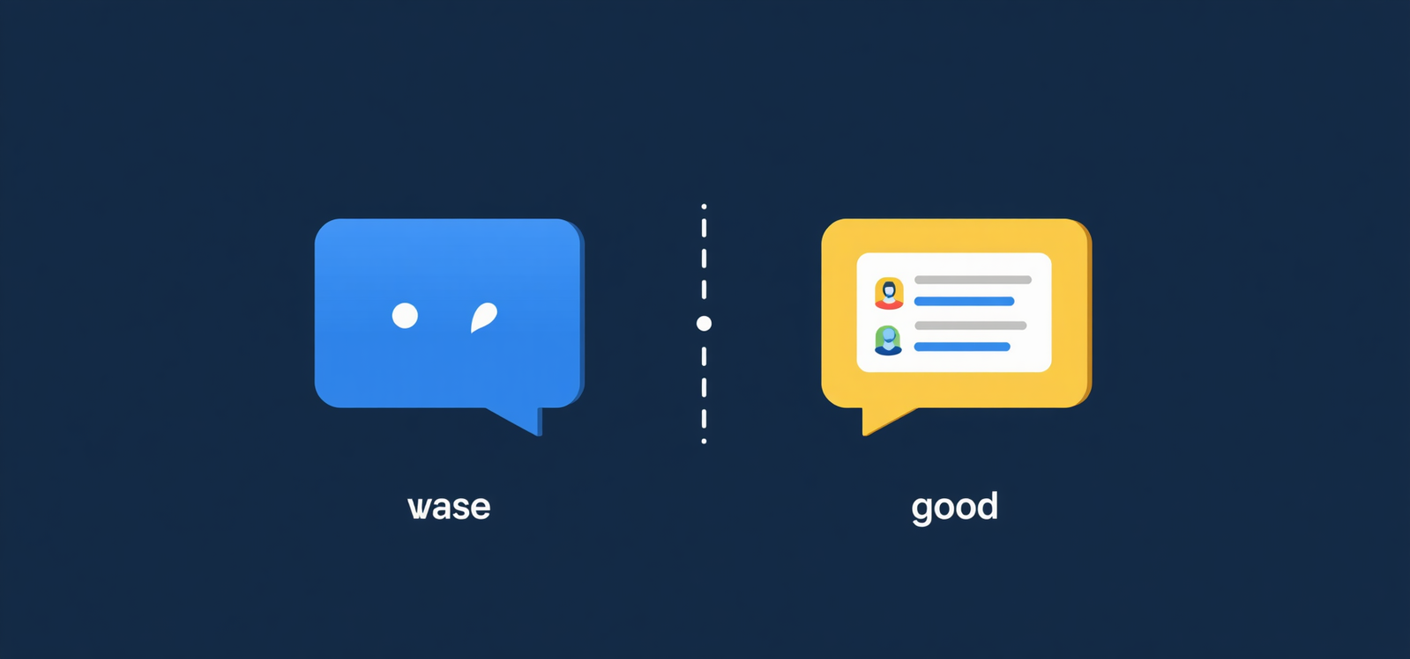

What is Prompt Engineering?
01
Write Better Instructions
Writing good instructions for AI to get better answers. It helps you get correct information, save time, get answers in the format you want, and improve overall AI output quality.
02
Good vs Bad Prompt
❌ Bad: "Tell me about AI."
✅ Good: "Explain AI in simple words with 3 examples."
Adding details to your prompt always leads to better, more useful answers from AI.

Slide 4





Good Prompt vs Bad Prompt
Good Prompt vs Bad Prompt
❌ Bad Prompt
✅ Good Prompt
❌ Bad Prompt
✅ Good Prompt
"Explain Python."
Not specific — AI doesn't know your level, language, or how many examples you need. You get a generic, unhelpful answer.
"Explain Python to beginners in simple words with 3 examples."
Topic → Python
Level → Beginner
Language → Simple
Examples → 3
"Explain Python."
Not specific — AI doesn't know your level, language, or how many examples you need. You get a generic, unhelpful answer.
"Explain Python to beginners in simple words with 3 examples."
Topic → Python
Level → Beginner
Language → Simple
Examples → 3

Slide 5

How to Write a Good Prompt?
Specific
Give exact information. Tell AI the topic, level, and scope. The more specific your prompt, the more accurate and useful the answer will be.
Clear
Simple & Detailed
Easy to understand. Use simple, direct language so AI knows exactly what you want. Avoid vague or ambiguous words.
Don't confuse AI with complex language. At the same time, provide necessary instructions and context so AI can give a complete answer.
Well-Structured
Tell AI how you want the answer — bullet points, paragraphs, or a list. 💡 Reminder: Clear Prompt = Better Answer!

Slide 6
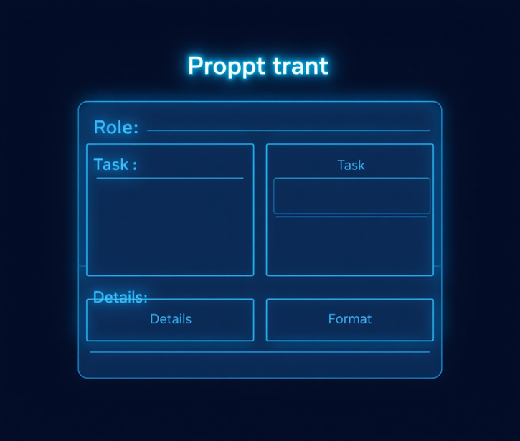

Simple Prompt Framework
Full Example
"Act as a teacher. Explain Machine Learning to beginners in 5 bullet points with examples."
Role → Teacher
Task → Explain ML
Details → Beginners
Format → 5 bullet points
Role & Task
  Role – Who should AI act as?
  Tell AI to take on a specific role.
  Example: "Act as a teacher."
  Task – What should AI do?
  Give AI a clear action to perform.
  Example: "Explain Machine Learning."
Details & Format
  Details – What information is needed?
  Provide context, level, and audience.
  Example: "For beginners."
  Format – How should the answer look?
  Specify structure of the response.
  Example: "In 5 bullet points with examples."

Slide 7
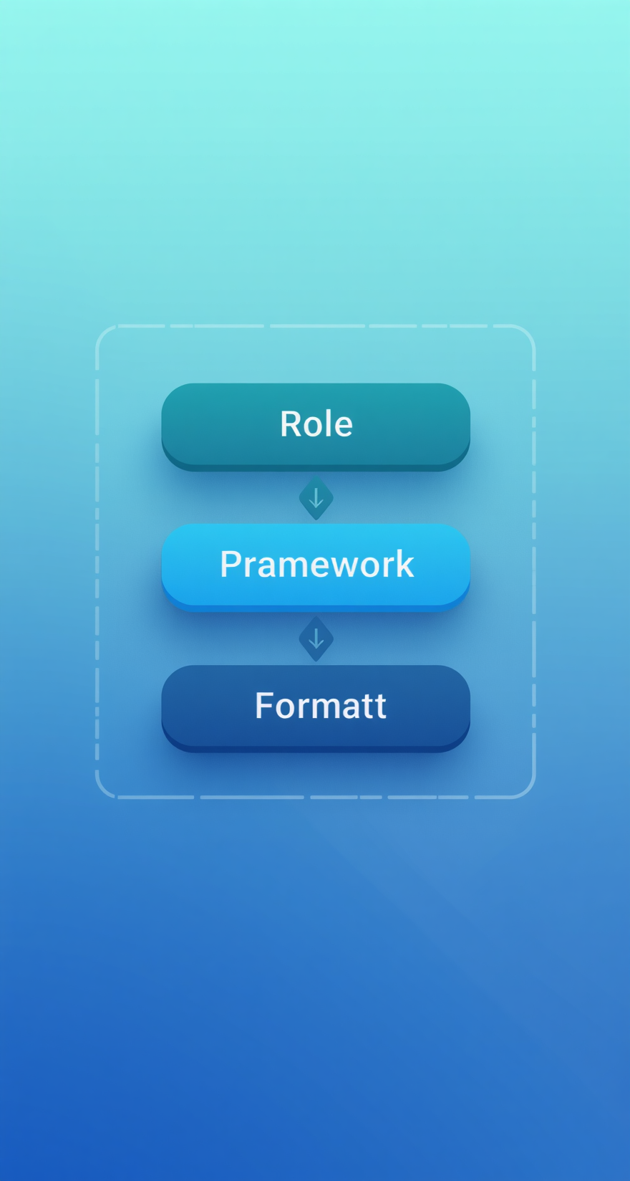
Prompt Framework – RTF
R → Role
Tell AI who to act as. Assigning a role helps AI respond with the right tone, expertise, and perspective for your specific need.
T → Task
Tell AI what to do. Be clear and specific about the action you want AI to perform — explain, summarize, create, list, compare, etc.
F → Format
Tell AI how to answer. Specify the structure: bullet points, paragraph, table, numbered list, etc.
Example: "Act as a teacher. Explain AI. Give the answer in simple bullet points."

Slide 8

Practical Example – Assignment
The Prompt
"Create an assignment about Artificial Intelligence. Include introduction, applications, advantages, disadvantages, and conclusion. Use simple English."
AI Can Help You Create
✅ Introduction ✅ Main Content ✅ Examples
✅ Advantages ✅ Disadvantages ✅ Conclusion

Slide 9

Practical Example – Summary
Prompt 1: Summarize a Topic
"Summarize Artificial Intelligence in 100 words using simple English."
Result: AI provides the most important points in short, easy-to-read form — perfect for quick understanding and revision.
Prompt 2: Summarize a Paragraph
"Summarize this paragraph in 5 simple bullet points."
Result: AI breaks down any text into clear, concise bullet points — making long content easy to understand and remember.

Slide 10
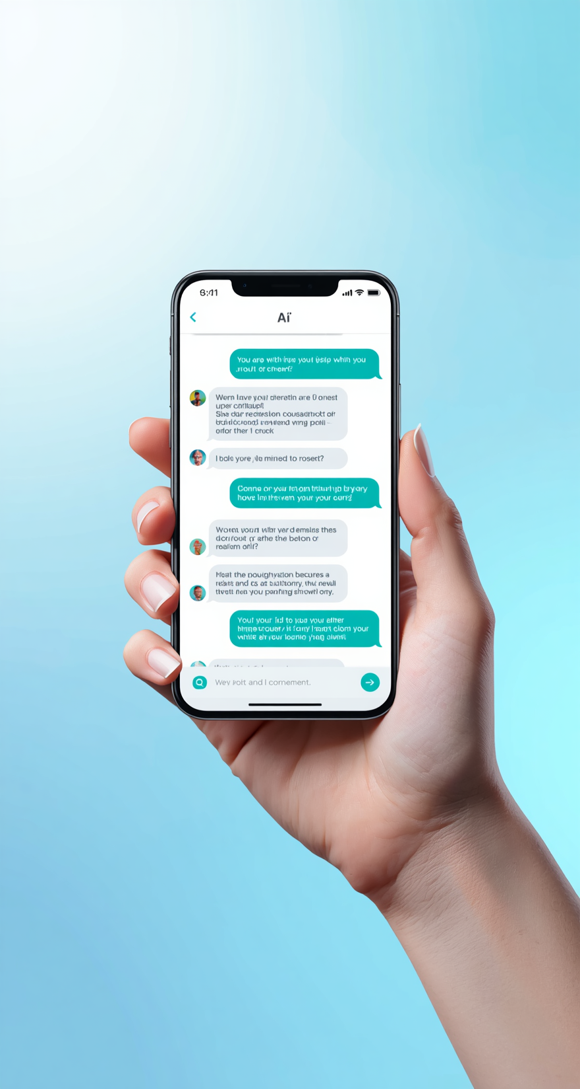
How to Improve a Prompt?
Simple Prompt
"Explain AI."
Basic and vague — AI gives a generic answer with little useful detail.
Better Prompt
"Explain AI in simple words."
Adding context helps AI understand your level and tone.
Much Better Prompt ✅
"Explain AI in simple words for college students. Give 3 real-life examples in bullet points."
🔑 Key Point: Adding details improves answers!

Slide 11

Common Prompt Mistakes
Bad Prompt Example
❌ "Write something about computers."
This is too vague — AI doesn't know what topic, level, format, or length you want.
Mistakes to Avoid
Good Prompt Example
❌ Unclear questions
❌ Very little information
❌ Missing format instructions
❌ Confusing instructions
❌ Copying AI answers without checking
✅ "Explain the 5 main uses of computers in simple English."
This is clear, specific, and tells AI exactly what you need.
Key Reminder
Always be clear, specific, and structured. A better prompt leads to a better answer. Review AI responses critically — never copy without checking!

Slide 12

Responsible Use of AI
Verify & Think Critically
Always check the information AI provides. Don't blindly copy AI answers — verify facts, use your own ideas, and combine AI help with your own thinking.
Why It Matters
Protect Your Privacy
AI is a powerful tool, but it must be used wisely. Always think critically, verify what AI tells you, and use it to support your learning — not replace it.
Never share private or sensitive information with AI tools. Protect your personal data, passwords, and confidential details when using any AI platform.
Follow the Rules
Use AI for learning, not as a replacement for effort. Follow your college or company's AI guidelines. Remember: AI is a helper, not a substitute for your own growth.

Slide 13




Use Case – Assignments & Summaries
Use Case – Assignments & Summaries
📝 Assignments
📄 Summaries
📝 Assignments
📄 Summaries
✅ Create ideas
✅ Create outlines
✅ Explain topics
✅ Improve grammar
✅ Shorten long text
✅ Find important points
✅ Create bullet points
✅ Make easy notes
✅ Create ideas
✅ Create outlines
✅ Explain topics
✅ Improve grammar
✅ Shorten long text
✅ Find important points
✅ Create bullet points
✅ Make easy notes

Slide 14

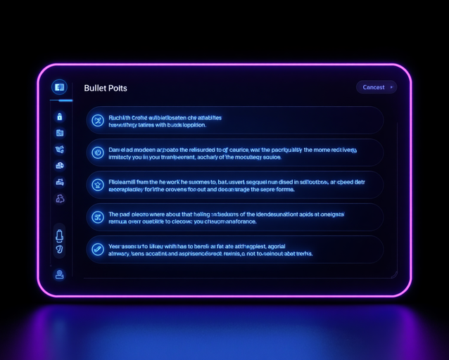
Practice Activity
Example Prompt
"Act as a teacher. Explain Machine Learning to beginners using simple words and 3 real-life examples in bullet points."
Try writing your own version now!
Your Task
Create a prompt for: "Explain Machine Learning."
Who? → Teacher
What? → Explain Machine Learning
For whom? → Beginners
How? → Simple words
Format? → Bullet points
Build Your Prompt
Use the RTF Framework:
Role → Act as a teacher
Task → Explain Machine Learning
Format → Bullet points with examples
Combine all parts into one clear prompt!

Slide 15

Learning Outcome
After This Lesson, You Can:
✅ Understand what a prompt is
✅ Write good prompts
✅ Identify good and bad prompts
✅ Use simple prompt frameworks
✅ Create assignments and summaries using AI
✅ Get better answers from AI
Keep practicing and explore prompt engineering further!

